Slide 1
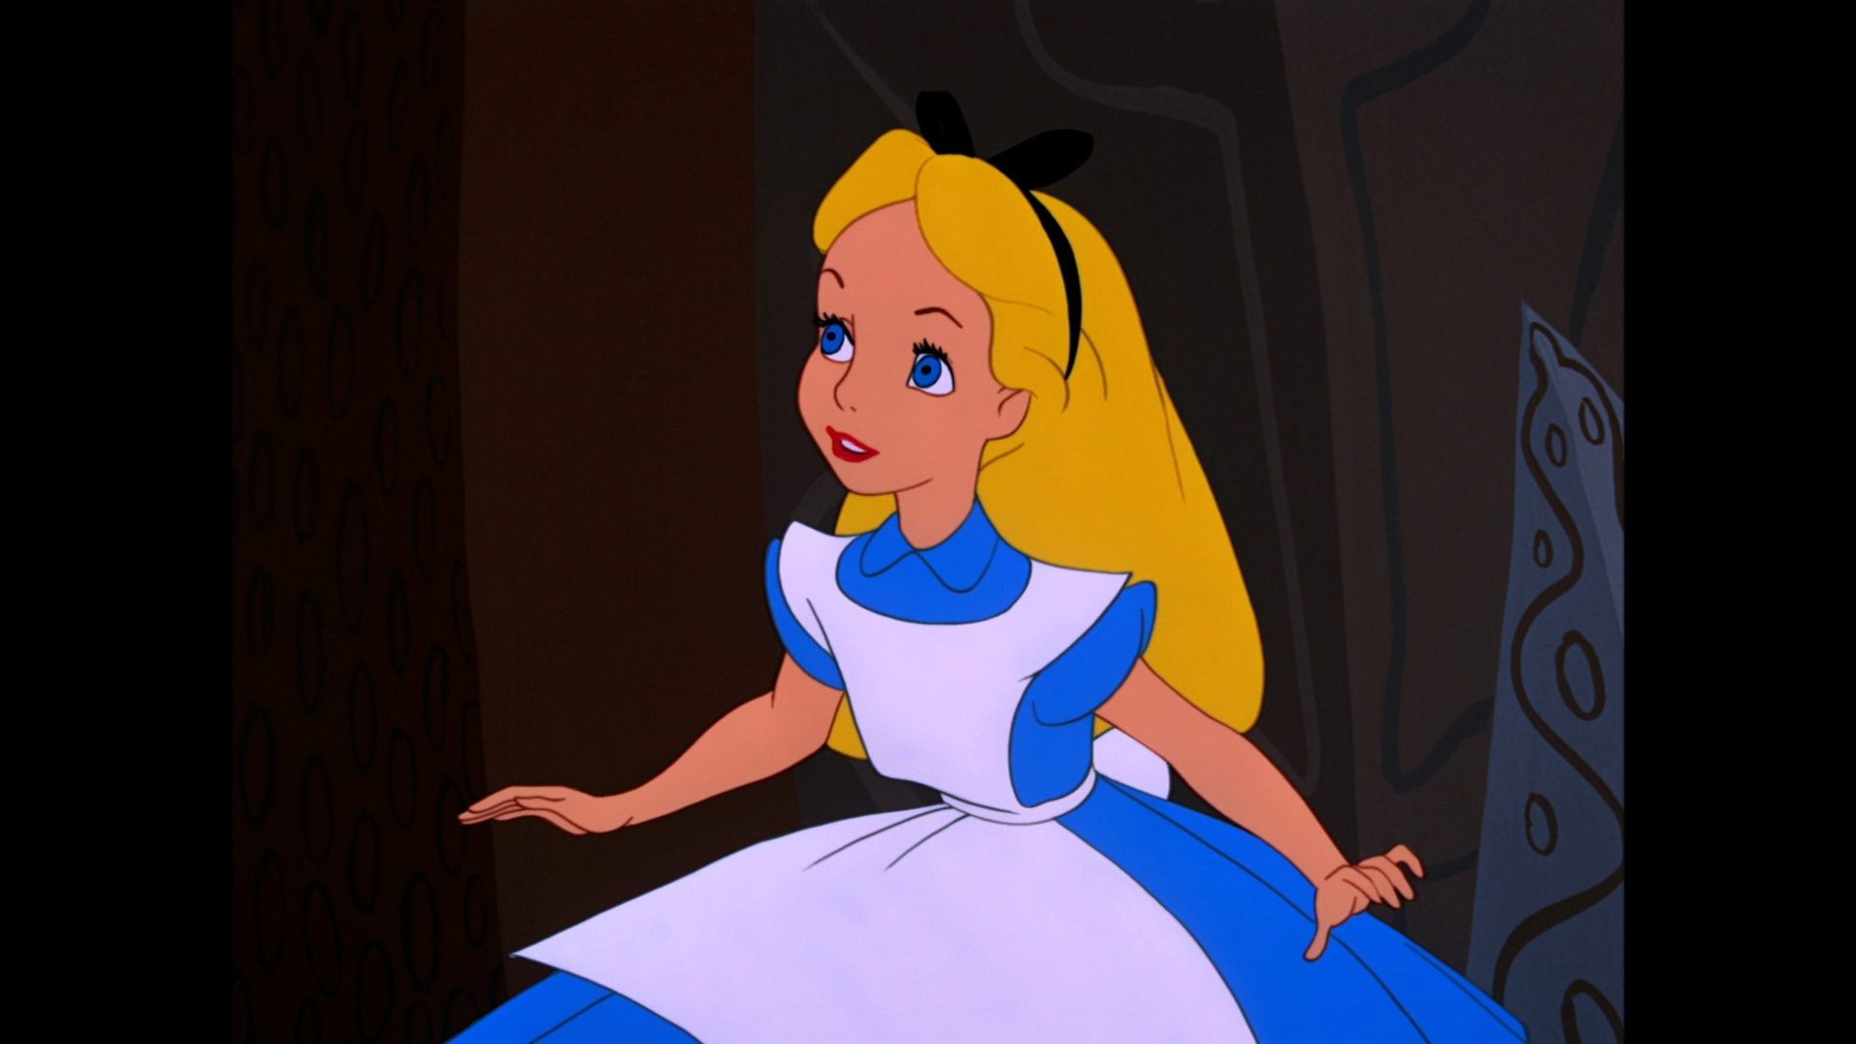
ALICE
Alert
Lockdown
Inform
Counter
Evacuate
Alice in Wonderland

Slide 2
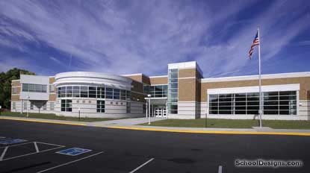
Sometimes I have a drill at school.
Drills help me practice how to stay safe in case of an emergency.
My school is a safe place.

Slide 3
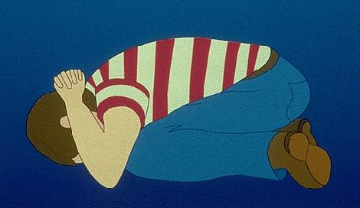
I practice what to do in case of a fire.
I practice what to do in case of bad weather.
I practice to stay safe at school.

Slide 4
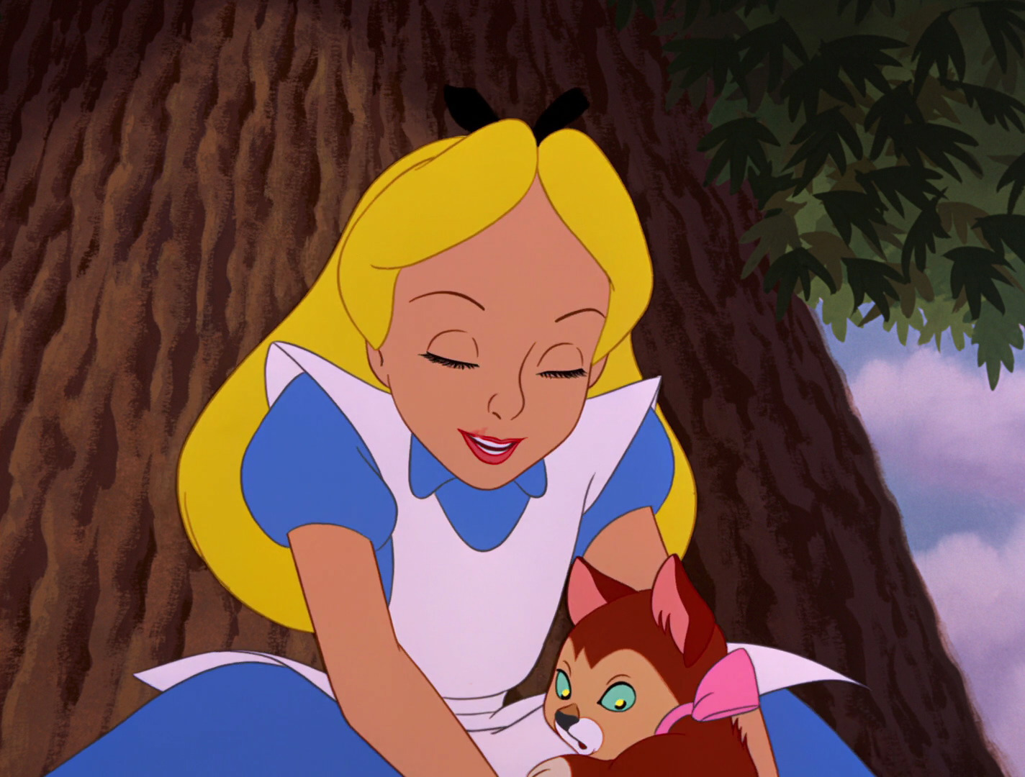
I have a new drill to practice.
I will practice the ALICE drill at school.
I will practice the ALICE drill at school to help me stay safe at school.

Slide 5
An ALICE drill is to practice what to if there is a bad guy in my school.
A bad guy is someone who is not allowed to be at my school. My teachers and principals want me to be safe.
Bad guys almost never come into schools, but just in case, I need to practice what do. This will help me stay safe!
A bad guy can be a guy and/or a girl.

Slide 6
Alert & Inform
When the ALICE drill begins, there will be an announcement over the speaker.
Someone will say, “We have ‘bad guys’ in the building” and will tell us where the bad guys are in the building.

Slide 7
When I hear this announcement, I will be quiet and listen very carefully to the teacher.
I will follow the teachers’ directions very carefully.

Slide 8
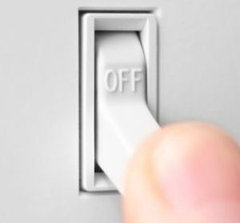
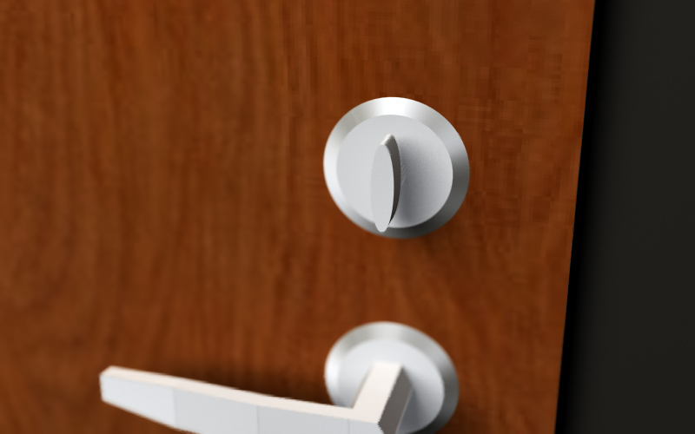
Lockdown
My teacher may tell me to stay in the classroom.
My teacher will lock the door and turn off the lights to keep me safe.

Slide 9
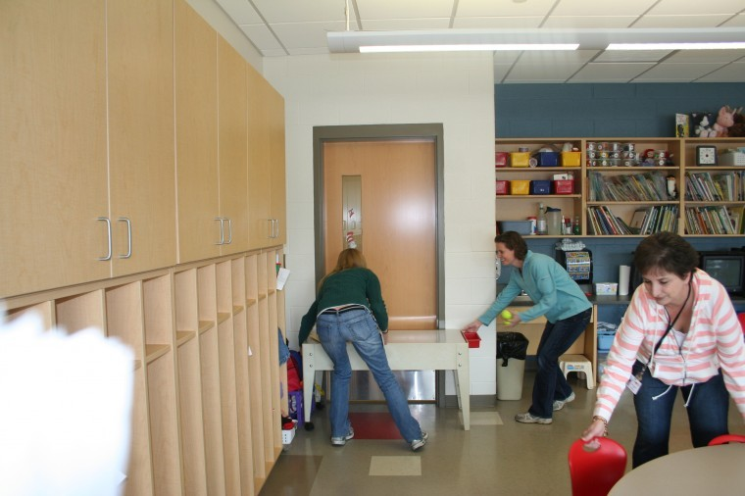
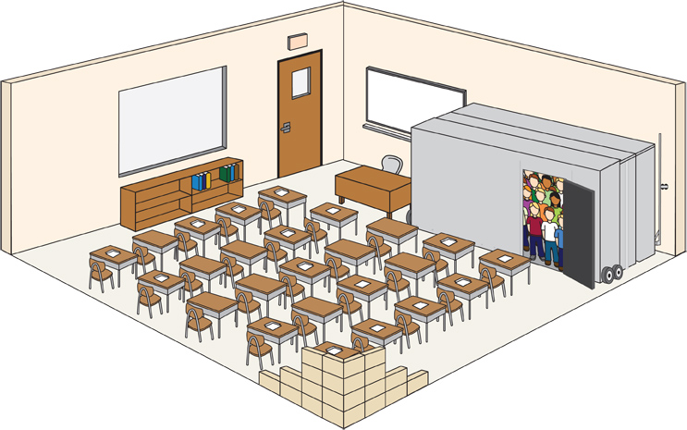
My teacher will block the door to keep us safe.
My teacher will tell me where to hide to make sure I cannot be seen.

Slide 10
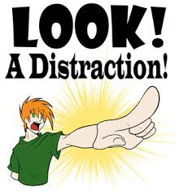
Counter
If I have to stay in the classroom and a bad guy comes into the room, I can still help protect myself.
I can:
Scream
Run
Throw things at the bad guy

Slide 11
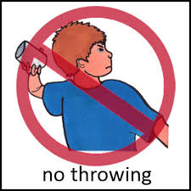
I will NOT throw items at anyone during a drill.
I know ALICE is a very serious event.
I will only take action against another person to protect myself.

Slide 12
Evacuate
My teacher may tell me that we are leaving the classroom and evacuating the building.
I will leave the classroom just like I do during a fire drill.
I may have to leave the building through a different door. I will make sure I follow my teacher’s instructions.

Slide 13
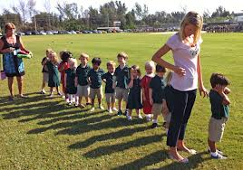
As I leave the classroom I will remain silent and move quickly with my teacher.
I will remain quiet so I can listen to my teacher’s directions.
I will make sure I stay with my classmates.

Slide 14
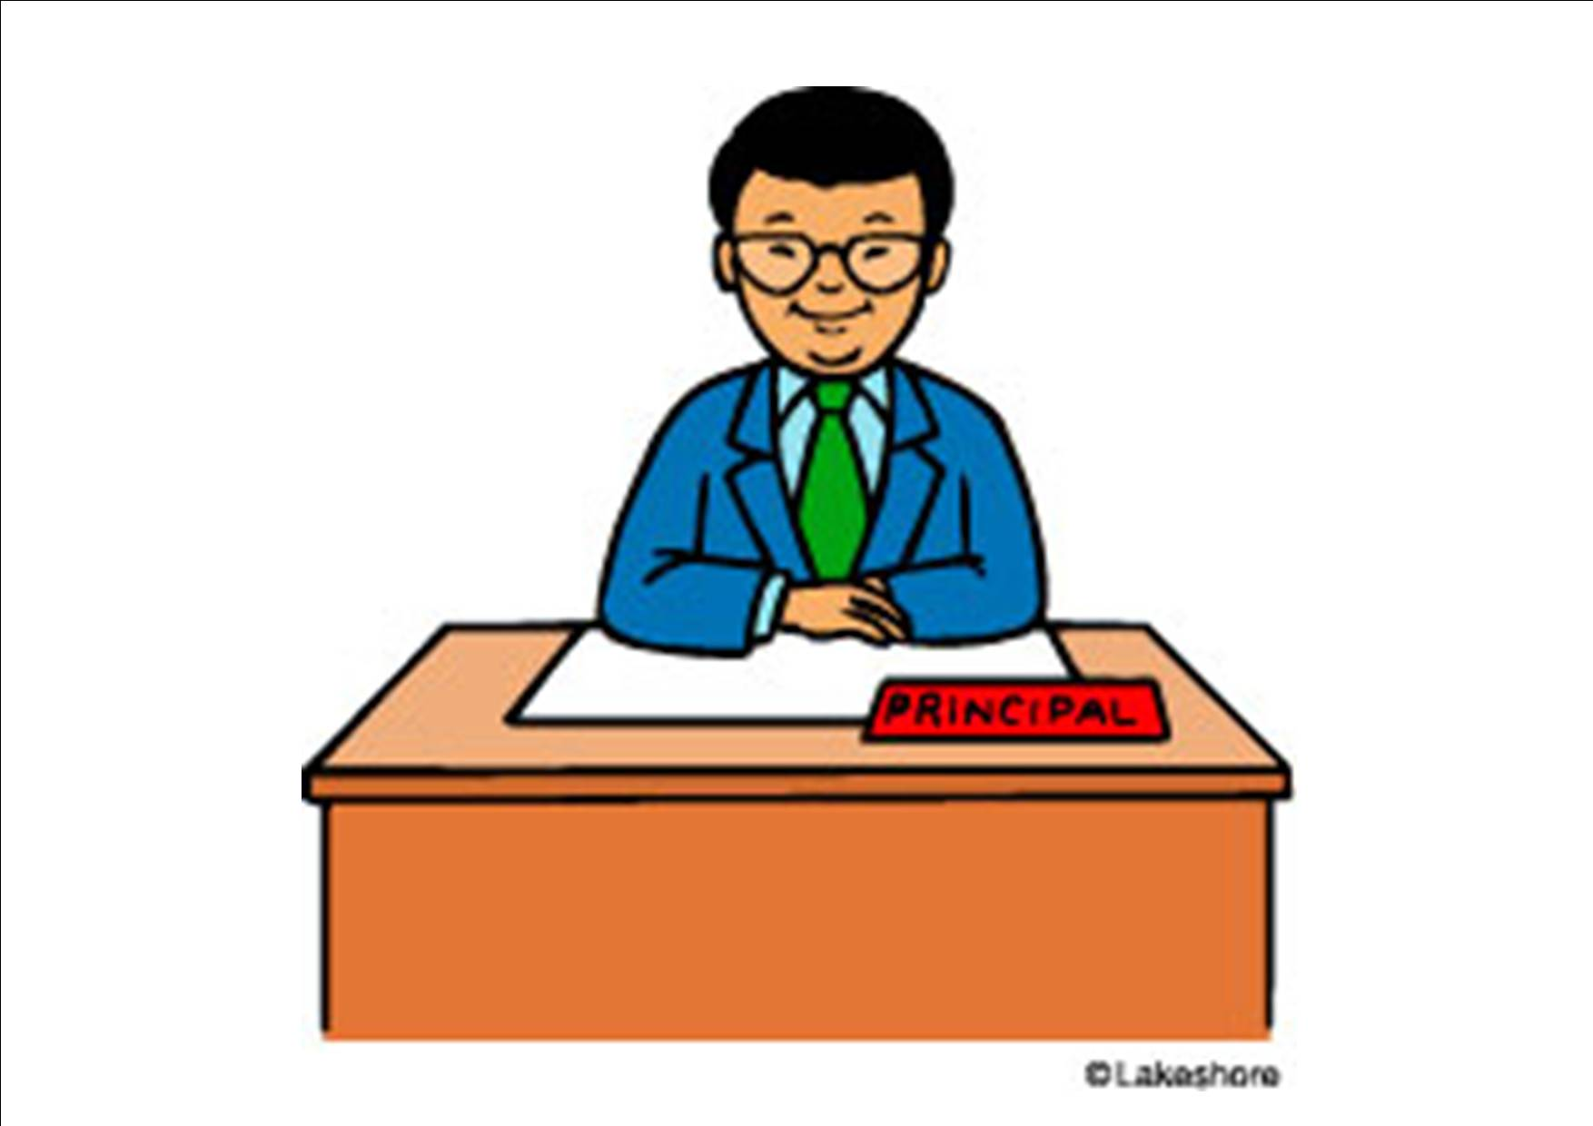
The principal and the police officers will check the school and my classroom to make sure everything is safe.
The principal will make an announcement and say, “All clear”.
When I hear that announcement I will follow my teacher’s instructions to go back to class.

Slide 15
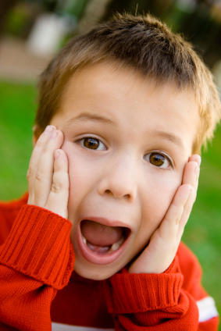
Feeling Scared
When I practice the ALICE drill, I may feel scared or nervous.
It’s okay to feel scared or nervous during a drill.
I feel better knowing that my teacher, and friends are following the directions so we stay safe.

Slide 16
An ALICE drill is a way for me to practice being safe at school!

